Slide 1
Mobile: Native Apps, Web Apps, &Hybrid Apps

Slide 2
Native Apps
Native apps live on the device and are accessed through icons on the device home screen.
Native apps are installed through an application store (such as Google Play or Apple’s App Store).
They are developed specifically for one platform, and can take full advantage of all the device features–they can use the camera, the GPS, the accelerometer, the compass, the list of contacts, and so on.
They can also incorporate gestures (either standard operating-system gestures or new, app-defined gestures).
Native apps can use the device’s notification system and can work offline.

Slide 3
Native Apps (continued)
In a nutshell, native apps provide the best usability, the best features, and the best overall mobile experience. There are some things you only get with native apps:
Multi touch - double taps, pinch-spread, and other compound UI gestures
Fast graphics API - the native platform gives you the fastest graphics, which may not be a big deal if you’re showing a static screen with only a few elements, or a very big deal if you’re using a lot of data and require a fast refresh.
Fluid animation - related to the fast graphics API is the ability to have fluid animation. This is especially important in gaming, highly interactive reporting, or intensely computational algorithms for transforming photos and sounds.
Built-in components - The camera, address book, geolocation, and other features native to the device can be seamlessly integrated into mobile apps. Another important built-in component is encrypted storage.
Ease of use - The native platform is what people are accustomed to, and so when you add that familiarity with all of the native features they expect, you have an app that’s just plain easier to use.

Slide 4
Native Apps (continued)
Documentation - There are over 2500 books alone for iOS and Android development, with many more articles, blog posts, and detailed technical threads on sites like StackOverflow.
Native apps are usually developed using an integrated development environment (IDE).
IDEs provide tools for building debugging, project management, version control, and other tools professional developers need.
While iOS and Android apps are developed using different IDEs and languages, there’s a lot of parity in the development environments.
You need these tools because native apps are more difficult to develop.
Likewise, the level of experience required is higher than other development scenarios, you don’t just cut and paste Objective-C and expect it to work.
While we’ve touched on native apps from a development perspective, there’s also the more important perspective: the end user.
When you’re looking for an app, you’ll find it in the store.
When you start the app, it fires up immediately.
When you use the app, you get fast performance, consistent platform look and feel.
When your app needs an update, it tells you so.

Slide 5
Native Apps (continued)
Native App Pros:
Native access to the phone’s senses
Native access to the phone’s data
Offline storage
Richer GUI options
App Store monetisation/In-App Purchases
Native App Cons:
Different Development Technologies
Different IDEs
Duplicate development efforts
Increased support costs
App Store approval queues

Slide 6
Mobile Web Apps
An HTML5 mobile app is basically a web page, or series of web pages, that are designed to work on a tiny screen.
Web apps are not real apps; they are really websites that, in many ways, look and feel like native applications.
They are run by a browser and typically written in HTML5.
Appropriate when content is constantly changing.
Users first access them as they would access any web page: they navigate to a special URL and then have the option of “installing” them on their home screen by creating a bookmark to that page.
Web apps became really popular when HTML5 came around and people realized that they can obtain native-like–functionality in the browser.
The popularity of HTML5 has blurred the distinction between web apps and regular apps by offering native-like–functionality in the browser itself. Although web apps are very close to native apps in appearance, there are many features that remain inaccessible in the browser such as the notifications, accelerometer information and other complex gestures.

Slide 7
Mobile Web Apps(continued)
An important part of the "write-once-run-anywhere" HTML5 methodology is that distribution and support is much easier than for native apps.
Need to make a bug fix or add features? Done and deployed for all users.
For a native app, there are longer development and testing cycles, after which the consumer typically must log into a store and download a new version to get the latest fix.
Multiple UI frameworks are available for solving some of the most complex problems that no developer wants to reinvent.
iScroll does a phenomenal job of emulating momentum style scrolling
JQuery Mobile and Sencha Touch provide elegant mobile components

Slide 8
Mobile Web Apps(continued)
So if HTML5 apps are easier to develop, easier to support, and can reach the widest range of devices, where do these apps lose out?
We already reviewed the major benefits of native development, so we'll just reiterate that you can't access native features on the device.
Users won’t have the familiarity of the native look and feel, or be able to use compound gestures they are familiar with.
But strides are being made on all fronts, and more and more functionality is supported by browsers all the time.
Limitations, especially for enterprise mobile, are offline storage and security
While you can implement a semblance of offline capability by caching files on the device, it just isn't a very good solution
Also, if a web app with authentication is launched from the desktop, it will require users to enter their credentials every time the app it is sent to the background
Therefore, if security is of the utmost importance, it can be the deciding factor on which mobile technology you choose

Slide 9
Mobile Web Apps(continued)
Mobile Web Pros:
Cross-platform
Open standards
No proprietary programming languages
Lowest barrier for first time use
Easier reuse of existing enterprise tech
No dependency on app stores
You control application updates
Mobile Web Cons:
No disconnected state
No access to (most of) the phone’s senses
Device testing a challenge
Writing multiple implementations
No marketing/distribution through app store
User interactions not native

Slide 10
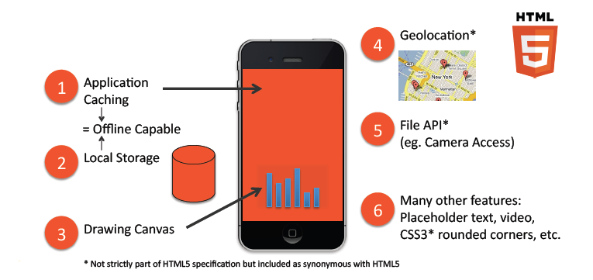
HTML5 A collection of features

Slide 11
Hybrid Apps
Hybrid apps are built using a combination of HTML and JavaScript and packaged with a framework like PhoneGap or Appcelerator Titanium or a custom native shell.
They are part native apps, part web apps. (Because of that, many people incorrectly call them “web apps”).
Like native apps, they live in an app store and can take advantage of the many device features available. Like web apps, they rely on HTML being rendered in a browser, with the caveat that the browser is embedded within the app.
Often, companies build hybrid apps as wrappers for an existing web page; in that way, they hope to get a presence in the app store, without spending significant effort for developing a different app.
Hybrid apps are also popular because they allow cross-platform development: that is, the same HTML code components can be reused on different mobile operating systems, reducing significantly the development costs.
Tools such as PhoneGap and Sencha Touch allow people to design and code across platforms, using the power of HTML
Hybrid apps are great when you are mobilising an existing web app, but you need app store exposure, you want native app coverage across all platforms, your mobile web functions do not require disconnected state, and you require access to the phone’s hardware for some features.

Slide 12
Hybrid Apps (continued)
Hybrid App Pros:
Majority of content portable (developed on mobile web)
Disconnected state possible
Some screens can be developed natively
Notifications can be supported
App Store exposure/monitisation
Decreased costs for multi-platform
Full device capabilities
Hybrid App Cons:
Decreased user experience for mobile web delivered content
Offline access not trivial for mobile web screens
Multi-platform wrapper requires native and mobile web technology know-how

Slide 13
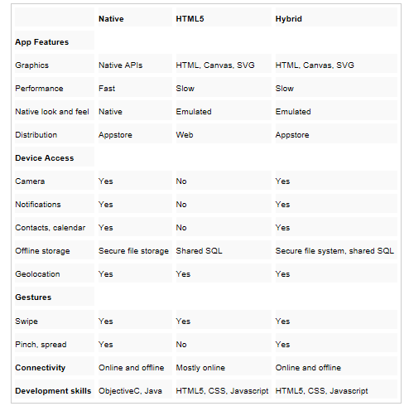
Summary!
Let's sum the last few slides up another way…

Slide 14
